Slide 1
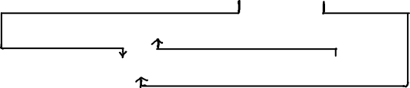
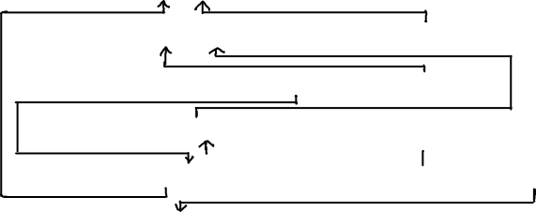

Route | id | departure_airport | arrival_airport | rprice
Airport | code | name | country
WeeklyFlight | id | time | day_of_week | wschedule | route
WeeklySchedule | year | profit_factor
Flight | fnumber | week | nbookings | wflight
Reservation | rnumber | flight
Passenger | passport | name | reservation
Ticket | ticketnr | booking | passenger
Contact | passengerid | email | phone
Booking | reservation | price | contact | payer
Payer | id | name
CreditCard | number | owner | expiration_date
WeekDay | name | factor

Slide 2
Route | id → (departure_airport, arrival_airport, rprice)
City | id → (name, country)
Airport | code → (name,city)
WeeklyFlight | id → (“everything else“)
WeeklySchedule | year → profit_factor
Flight | fnumber → week, nbookings, wflight
Reservation | rnumber → flight
Passenger | passport → name
Ticket | ticketnr → (booking, passenger)
Contact | passengerid → (email, phone)
Booking | reservation → (price, contact, payer)
Payer | id → name
CreditCard | number → (owner, expiration_date)

